Slide 1

LITERATURE SURVEY
IMPLEMENTING VIRTUAL ASSISTANT USING CNN FOR TRAVEL PLANNER
UNDER THE GUIDANCE OF
Dr. D Santhosh Kumar
Assistant Professor , ECE
VNRVJIET
PRESENTED BY: Batch-15, ECE-4
G VAMSHIDHAR - 17071A04K5
N RAJESH - 17071A04M5
RAM PENTAPATI - 17071A04N1
P PAVAN KUMAR - 18075A05445

Slide 2


Introduction
This Pandemic had made everything online/digital to avoid Physical distance/ Human Contact.
Digital Process is new to many people, They have of lot of queries related to working of applications, Organizations hire people for customer support but due no of increasing customers, customer support/executive can handle hundreds people at a time.
So most of the people queries remained unsolved.
Here comes Virtual Assistant into picture.

Slide 3
OVERVIEW OF THE PROJECT
Virtual Assistant implentation using Convolutional Neural Network (CNN).
Collecting Data from different Resources.
Implementing Virtual Assistant for Travel Planner
Showing Categories of places (Hill Stations, Waterfalls).
Selecting State for vacation.
Displaying basic journey details (Travel duration, Mode of Transport, Cost).
Opting for mode of transport based on their interest.
Integrating this model with web-application.

Slide 4

Problem statement
Organisations are spending huge amount on customer support, Customer support, Customer Service and still unable to resolve all the queries of Users efficiently.
Virtual Assistant would reduce the amount spent, work pressure on Customer Support and Enhance User experience

Slide 5
Motivation
ACrazyTourist, Start-up (Yet to be recognised by Government of India).
It is start-up they plan for trips based on customer interest, As they are start-up hiring customer support is not possible. Our Virtual Assistant would be useful in guiding the customers to select their trip based on their interest/requirement.

Slide 6

Aim of the project
THE AIM OF THIS PROJECT IS TO
To build Virtual Assistant that answers the queries of the users.
Implementing Virtual Assistant for Travel Planner
Integrating model with that web-application.

Slide 7
objectives OF THE PROJECT
To enable user input in both text and speech/voice.
To Display output based on user requirement (text or Speech/voice).
To Answer maximum number of possible queries.
Building Virtual Assistant for Travel Planner.
To Integrate Model with web-application.

Slide 8


OBJECTIVE 1: To enable user input (text or speech)
Our Virtual Assistant will be accepting the input as text or speech, To accept speech as input we will be using system microphone, Speech recognition (Python Library).
Later using Speech-to-Text conversion technique (Provided by Speech recognition library), Speech input is converted into text and processed.

Slide 9


OBJECTIVE 2: TO DISPLAY output (text or speech)
Output will be displayed based on user requirement, By default text will be displayed if user wants it in speech we use speech-to-text conversion technique (Provided by Speech Recognition Library) and text is converted into speech and displayed to user.

Slide 10

Objective 3: To integrate model with web-application
We will be building web-application using HTML,CSS, Bootstrap, Later we will be using Docker to integrate our model with web-application.

Slide 11
Literature survey
S.NO | NAME OF THE JOURNAL | YEAR | NAME OF THE AUTHORS | WORK CONTRIBUTED | MERITS AND DEMERITS OF WORK
1 | Critical Literature Review on Chatbots in Education (IJTSRD) | 2020 | Hephzibah Thomas | This paper focuses on text input and text output . And also this paper talks about usage of chat-bots in educational fields. | This paper only uses text to text . Using speech to speech and text to text or text to speech would be much better.
2 | Implementation of Virtual Assistant with Sign Language using Deep Learning and Tensor Flow | 2021 | Vani Valsaraj | This project converts sign language to text using deep learning and tensor flow. | This is explicitly useful for deaf and dumb. If output is in text, output in speech would be better.
3 | Jarvis - A Virtual Assistant based on Artificial Intelligence | 2020 | Dr.M. Sharada Varalakshmi, Dr.P. Lavanya | This paper talks about speech recognition approach. | This paper explained about approach of Speech recognition but not any implementation.
4 | A Review Paper on Smart Personal Assistant | 2016 | Yogendra Kumar Sharma Neeraj Sharma | This Paper talks about overview of applications of Smart Personal Assistant in various fields. | They didn't talk about any architecture Just gave a brief on Smart Personal Assistant.

Slide 12
Flow CHART of the project
Input (Text or Speech)
Tokenizing input
Stemming the input sentences
Comparing with intents
NO ERRORS
Fetching the results
Displaying the result (Text or Speech)

Slide 13
PROJECT STEPS
PROJECT STEPS | PROJECT OBJECTIVE DESCRIPTION
STEP 1 | Understanding Virtual Assistant working.
STEP 2 | Understanding Speech recognition, Text to Speech, Speech to Text Conversion.
STEP 3 | Collecting Data for Application.
STEP 4 | Writing Code for Entire Project.
STEP 5 | Training and Testing the model.
STATUS
DONE
IN PROGRESS
IN PROGRESS
IN PROGRESS
Yet to start

Slide 14
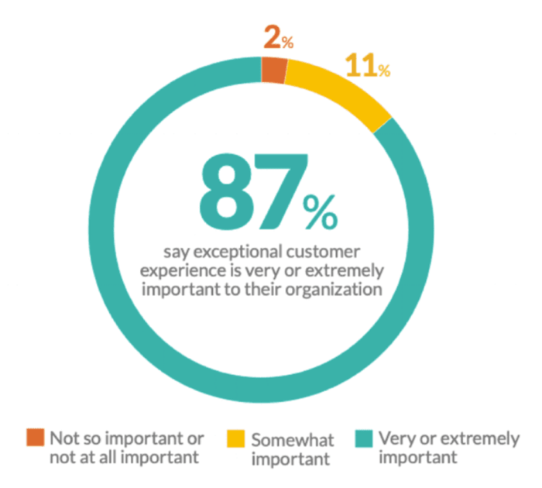
importance of proposed project in the context of current status
According to report on Smart Insights by Expert commentator states that 87% of customer base are concerned with customer service, Best Customer support will provide great experience
Hence, our proposed project will be of great use.

Slide 15
Expected outcome of the project
Virtual Assistant for Travel Planner.
User input: Text or Speech.
Output: Text or Speech.

Slide 16
applications
E-Ticketing Platforms (Hotels, Movie Tickets, Train Tickets, Flight Tickets).
Medical Field (Pharmacy, Clinic, Hospital).
E-Commerce website (Who Sell different kind of products).
Educational Institutions (To solve queries regarding Curriculum, Eligibility Criteria, Fee Structure and lot more).

Slide 17
TIME SCHEDULE OF ACTIVITIES
S.NO | TASK | TENTATIVE DATES & DURATION | NO. OF DAYS REQUIRED
1 | Problem statement and picturizing the project | 17-03-2021 to 21-03-2021 | 5
2 | STEP 1 | 26-03-2021 to 02-04-2021 | 7
3 | STEP 2 | 02-04-2021 to till date | -
4 | STEP 3 | 06-04-2021 to till date | -
5 | STEP 4 | 22-04-2021 to till date | -
6 | STEP 5 | 12-05-2021 to 15-05-2021 | 3
7 | Thesis Preparation | Before final review | 5
8 | Final Slides Preparation | Before final review | 3

Slide 18
SOFTWARE(s) USED in the project
Python
Pandas
NUMPY
Speech Recognition
Natural Language Processing (NLP)
Convolutional Neural Network (CNN)
Tools Used:
Google Collab.
VS CODE
Python IDE

Slide 19
ROLES AND RESPONSIBILITIES
S.NO | NAME OF THE STUDENT | ROLES AND RESPONSIBILTIES
1 | G VAMSHIDHAR(4K5) | Implementing Code, Training and Testing.
2 | N RAJESH(4M5) | Data Collection and Manipulation
3 | RAM PENTAPATI(4N1) | Code Execution, Research, Documentation
4 | P PAVAN KUMAR(445) | Research, Data Collection and Manipulation.
We team together work in all parts of the project to ensure that entire team is aware of what exactly happening in project.
So, roles and responsibilities are classified according to the Sources and feasibilities.

Slide 20
references
[1] Jarvis - A Virtual Assistant based on Artificial Intelligence, International Journal of Grid and Distributed Computing Vol. 13, No. 2, (2020), pp. 776 – 784
[2] Raychowdhury, A., Roy, K.: ‘Carbon-Nanotube-based voltage-mode multiple valued logic design’, IEEE Trans. Nanotechnology, 2005, 4, (2), pp. 168–179
[3] Moaiyeri, M.H., Doostaregan, A., Navi, K.: ‘Design of energy-efficient and robust ternary circuits for nanotechnology’, IET Circuits Devices Syst., 2011, 5, (4), pp. 285–296
[4] Lin, S., Kim, Y.-B., Lombardi, F.: ‘CNTFET-based design of ternary logic gates and Arithmetic circuits’, IEEE Trans. Nanotechnol., 2011, 10, (2), pp. 217–225
[5] Keshavarzian, P., Sarikhani, R.: ‘A novel CNTFET-based ternary full adder’, Circuits Syst. Signal Process., 2014, 33, pp. 665–679

Slide 21
References (continued)
[6] Sridharan, K., Gurindagunta, S., Pudi, V.: ‘Efficient multi ternary digit adder design in CNTFET technology’, IEEE Trans. Nanotechnology 2013, 12, (3), pp. 283–287
[7] Miller, D.M., Thornton, M.A.: ‘Multiple valued logic: concepts and representations’ (Morgan & Claypool Publishers, 2008)
[8] Stanford University CNTFET model, Website: Stanford University, Stanford, CA, 2008). Available at http://nano.stanford.edu/model_stan_cnt.htm
[9] Raychowdhury, A., Vivek De, K., Borkar, S.Y., et al.: ‘Variation tolerance in a multichannel carbon-nanotube transistor for high-speed digital circuits’, IEEE Trans. Electron Devices, 2009, 56, (3), pp. 383–392

Slide 22
Thank you
BATCH-15

